Slide 1


MADGLARE
PRODUCT REQUIREMENTS | USER REQUIREMENTS |BUSINESS REQUIREMENTS |TECHNICAL REQUIREMENTS |DELIVERABLES | USER STORIES | PERSONAS | TASKFLOWS | SURVEYS

Slide 2
PRODUCT REQUIRMENT-DEFINITION
What will the product do?
  Provide on-demand paparazzi for any occasion
What is the product’s main functionality?
  Inviting users to book paparazzi appointments.
What other actions should the product perform?
  Isolate service type e.g., wedding, nightclub, awards, birthday party etc.
How many sections does the product have?
  9 Service Sections
How many parameters?
  4 Paparazzi Parameter Types
How does each parameter work?
  After the appointment is booked, invites are sent to photographers to lock out event day on their calendars
Does your product require maintenance?
  Yes, plugin updates and upgardes
Does your product contain replaceable parts?
  API replacements if necessary

Slide 3
USER REQUIREMENT - RESEARCH
Who will be the primary user of the product?
  Instagram Generation | Influencers | Club Goers | Wedding Planners | Event Organizers | Entertainers | Prom ..
What is the age range for the user?
  24 - 55
Where does the user live?
  Los Angels, Miami, Las Vegas, Atlanta, New York, Chicago, Philadelphia, DC
How does the user live (lifestyle)?
  Extroverts
What are the user’s everyday life activities?
  Hey Social Media Participation, Celebrity Watchers, Entertaining
What are the user’s interests?
  Brand name products, watching and following celebrity shows, reality tv watchers, music, acting, speaking, influencer marketing, limelight related activities

Slide 4
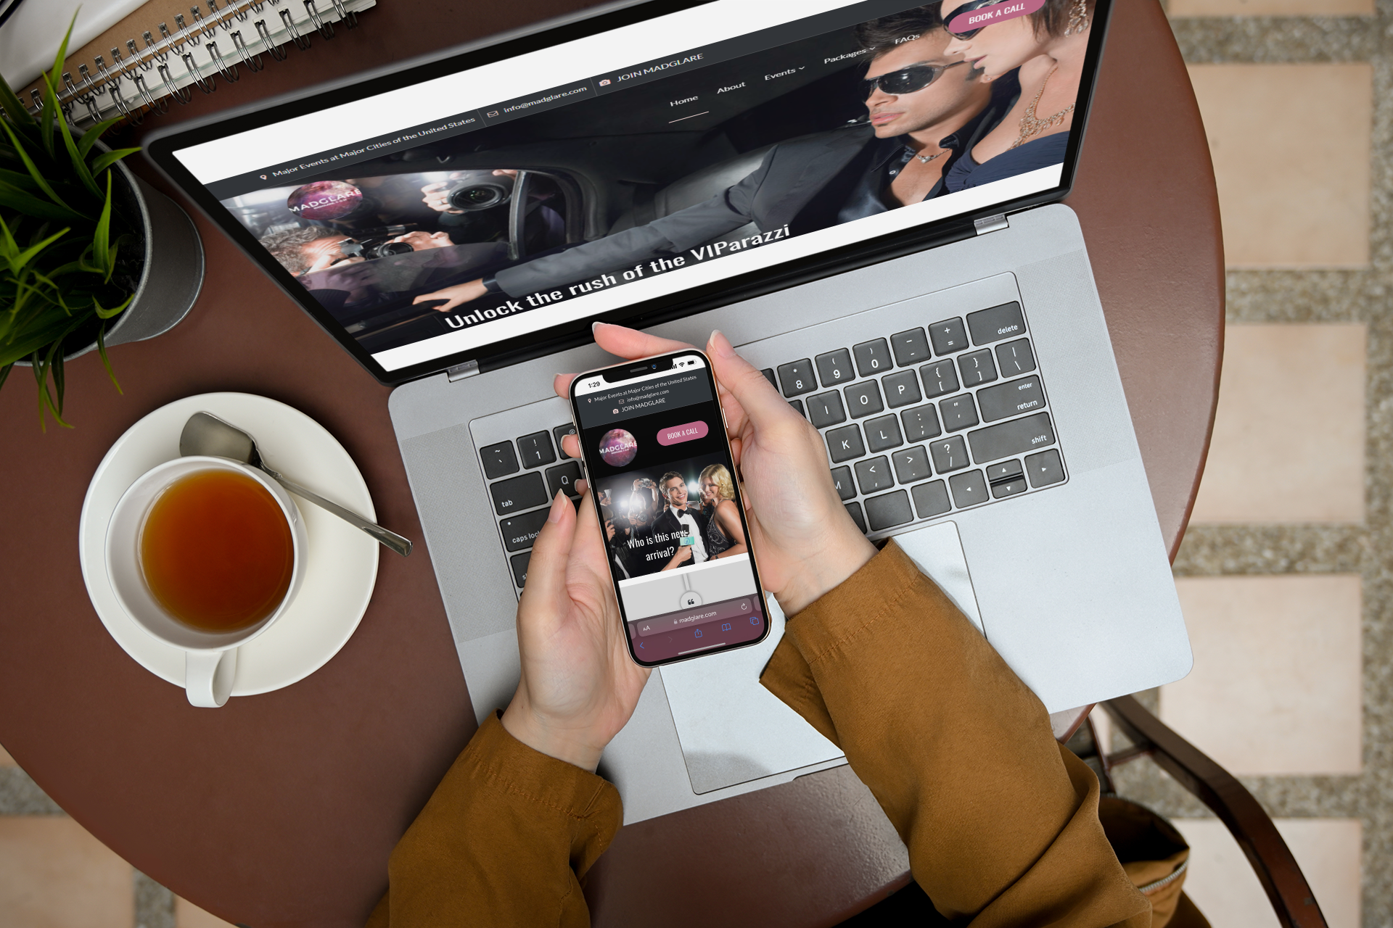
USER EXPERIENCE RELATIONSHIP
How will the user interact with the product?
  From Mobile Devices Mostly, and sometimes computer
What need will the product satisfy for the user?
  Ability to create instant fame in the real world: Where paparazzi pictures become viral sensations
How is the user currently satisfying this need?
  Social media posts
How much will the user be willing to spend on the product?
  At least $5,000 to create status purchase

Slide 5
Business Requirements
Branding
Competitors
Sales & Marketing
What branding should the product have?
  Corporate Branding | Service Branding | Geographic Branding
Is the branding shared?
  Yes, with Influencers and Partners
Does the product have an independent branding?
  Yes
Is the branding adaptable to the product?
  Yes
What is the main competitor for the product?
  Unsaturated Market, known competitors offer few options for User experience
What are the secondary competitors?
  Entertainment Photographers
What is the main competitor’s differentiator?
  Socially triggered
What is the differentiator of the proposed product vs. all competitors?
  User chooses experience to be noticed just like social media posts.
How will the product be sold?
  From Mobile Devices after agreement and date of event is agreed upon through Stripe Payment Processes
How will it be advertised?
  Instagram, Twitter, Influencers, and TV Commercials

Slide 6
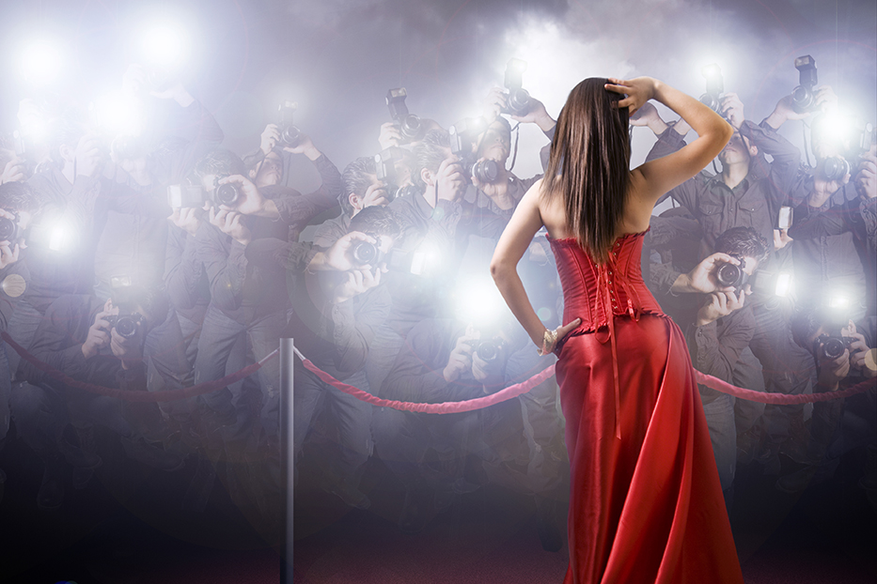
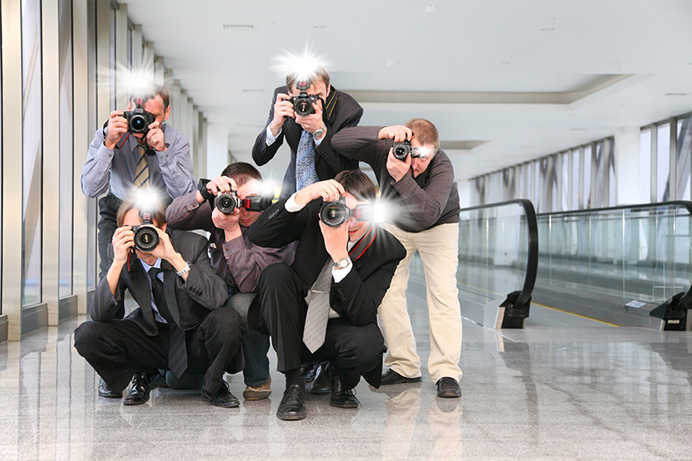
Business Requirements Cont.
Customer Service
Stakeholders
Connecting Users
What problems could the user encounter with the product?
  Securing a time for Paparazzi shoots
  Having enough saved to pay
  Being at the location of event at the right time for service to be provided
How can the user solve these problems?
  Training on how to maximize product use.
What channels are available for the user to seek customer service?
  Customer service hotline
What other stakeholders will be interacting with this product?
  Company and organizations that are launching products or company.
How will these stakeholders interact with the product?
  Purchase corporate launch package, and organize time around Madglare Paprazzi

Slide 7
Technical Requirement
Platforms & Devices
User Accessibility
In which operating system will the product be developed?
iOS, Android, Windows
Which devices will the product need?
mobile, tablet, wearables, desktop.
Are there any limitations for the product with regard to technology?
  Access to Photographers OnDemand nationwide

Slide 8
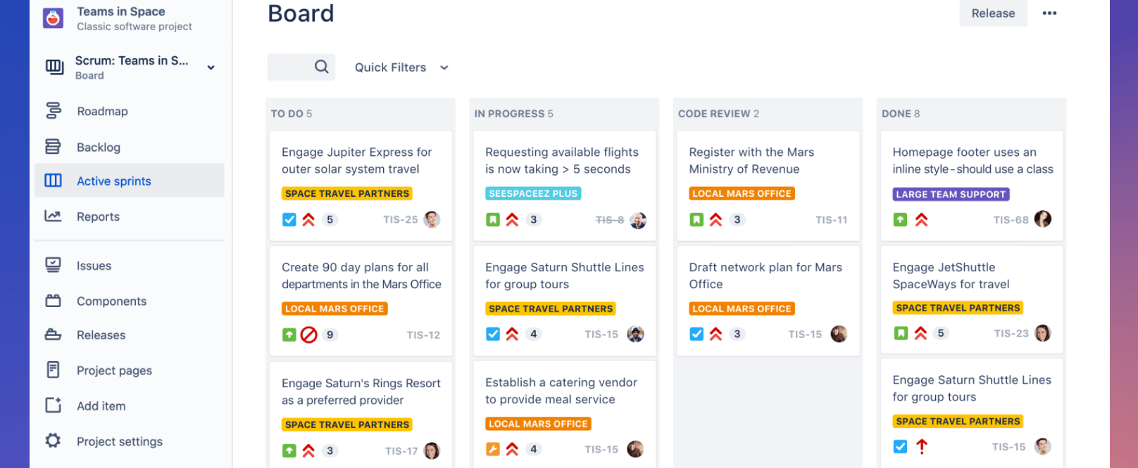
DELIVERABLES TRACKED IN SLACK, JIRA, TRELLO, AZURE DEVOPS
Tracked in 2 weeks to 3 weeks Sprint or in Kanban board where only progress is tracked (not time bound)

Slide 9
User Story - ANALYSIS
As A
I want
So that
Madglare User
Madglare Photographer
Madglare Agent
To be Able to Get a Paprazzi on Demand
To be Able to get gigs on demand to take pictures of Madglare Clients
I want secure as many agreements from clients tp book paparazzi teams
I can be raved about
I can create an eclectic portfolio of my works
I can increase commisions

Slide 10

User Personas
Margaret
James
Elliot

Slide 11
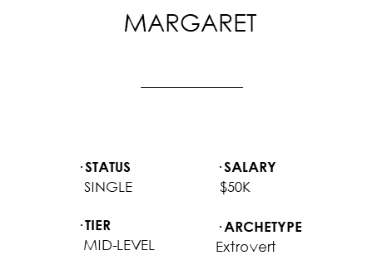
User Persona
Margaret
James
Eliot
Entertainer
Car Racing Influencer
Accountant
JAMES
ELLIOT
35, New York
45, MIAMI
^{· STATUS}
^{SINGLE}
^{· TIER}
^{MID-LEVEL}
^{· SALARY}
^{$150K}
^{· ARCHETYPE}
^{Attention Seeking}
^{· STATUS}
^{SINGLE}
^{· TIER}
^{MID-LEVEL}
^{· SALARY}
^{$100K}
^{· ARCHETYPE}
^{Attention Seeking}

Slide 12









PERSONALITY
BIO
“I want to become known in the entertainment industry”
Extrovert
Vocal
Social
Stylish
Attention Seeking
Margaret is a recent grad from Juliard and was one of the most notorious girls on campus. She has many friends and just secured a gig in an up-and-coming series that is yet to air.
She enjoys posting on social media outlets and can be seen trying to be the center of attention among her friends. She loves singing, acting and making her presence known at gatherings.
She seems to influence others easily and get people to do what she wants charmingly.
“
Behavior
Rising TV Talent
Use of media tools
Communication
Motivations
Comfort with Photos
PHOTOGRAPHY
SELF PROMOTION
Ambitious
POPULARITY
USER TECH ABILITY
Influences
Goals
Frustrations
· CELEBRITIES
· SOCIAL MEDIA
· REALTY TV
· FASHION BLOGS
· TRENDING ART
· MUSIC LYRICS
Increase her brand awareness as a rising talent.
Create controversial experiences that can make her gain popularity.
Have more pictures to brag about
Few companies that can give her exposure properly
Being available to increase brand awareness
Having celebrity status
MARGARET
29, Los Angeles
Frequently used apps
ENTERTAINER
^{· STATUS}
^{SINGLE}
^{· TIER}
^{MID-LEVEL}
^{· SALARY}
^{$50K}
^{· ARCHETYPE}
^{Extrovert}
Instagram
Twitter
Facebook

Slide 13
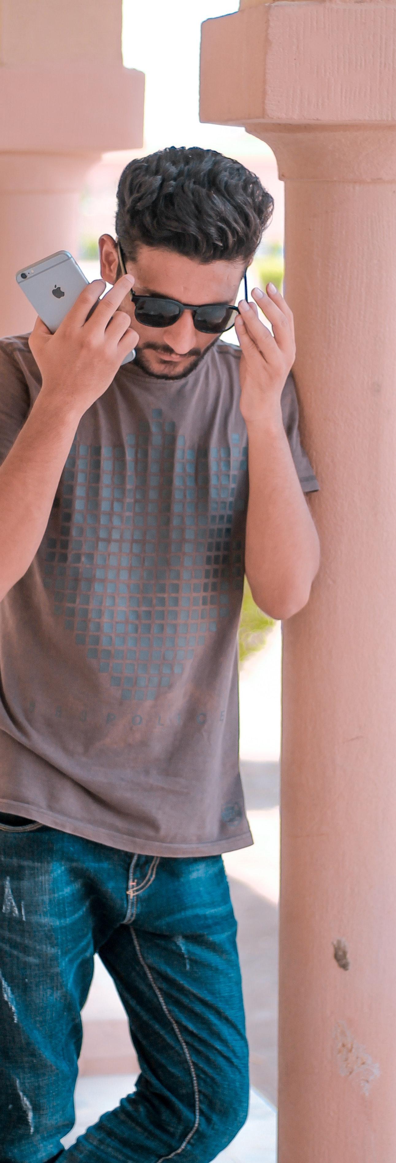

PERSONALITY
BIO
“I want to create awareness around my racetrack stunts.”
Extrovert
Charming
Social
Stylish
Attention Seeking
James is a YouTube influencer, that shows off his driving skills on racetracks with a group of friends. He has been doing this for over 5 years and has a high number of followers on YouTube.
Hs enjoys fixing cars and adding specs to cars and enjoys going to parties. If he is not driving cars, he is traveling to different parts of the country to mingle with likeminded industry types
“
Behavior
Influential
Use of media tools
Communication
Motivations
Comfort with Photos
PHOTOGRAPHY
SELF PROMOTION
Ambitious
POPULARITY
USER TECH ABILITY
Influences
Goals
Frustrations
· ACTION MOVIES
· SOCIAL MEDIA
· RACE TRACKS
· CAR BLOGS
· MUSCLE CARS
· RAP MUSIC
Increase her brand awareness as a race car enthusiast.
Create more followers for his youtube channel.
Have more pictures to brag about
Few companies that can give her exposure properly
Being available to increase brand awareness
Having celebrity status
JAMES
35, New York
Frequently used apps
INFLUENCER
^{· STATUS}
^{SINGLE}
^{· TIER}
^{MID-LEVEL}
^{· SALARY}
^{$150K}
^{· ARCHETYPE}
^{Attention Seeking}
Instagram
Twitter
YouTube

Slide 14
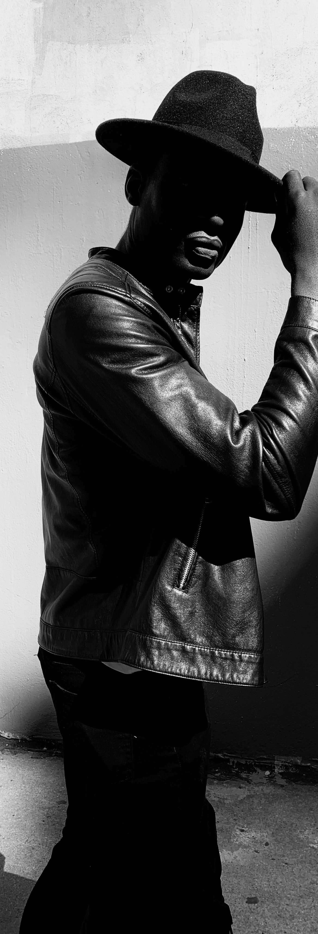
PERSONALITY
BIO
“I want to a wedding that is the talk of town.”
Extrovert
Ambitious
Social
Stylish
Attention Seeking
Elliot is an accounting professional that enjoys parties and meeting people. He travels a lot for work because he has international clients.
He just found his perfect mate and is looking forward to getting married in the near future. He loves being the center of attention and could be very vocal with his opinions.
He also enjoys working out and going to the gym. He has a lot of friends and is well liked.
“
Behavior
Influential
Use of media tools
Communication
Motivations
Comfort with Photos
PHOTOGRAPHY
SELF PROMOTION
Ambitious
POPULARITY
USER TECH ABILITY
Influences
Goals
Frustrations
· ROMANTICS
· SOCIAL MEDIA
· ELON MUSK
· ENTREPRENEUR
· REALITY TV
· FASHION BLOGS
Do something different that gets people talking
Have some interesting pictures for the wedding
Make him and his wife the centre of attention
Few companies that can give her exposure properly
Being available to do something thrilling that is not common
Having fun that is newsworthy.
ELLIOT
45, MIAMI
Frequently used apps
GROOM TO BE
^{· STATUS}
^{SINGLE}
^{· TIER}
^{MID-LEVEL}
^{· SALARY}
^{$100K}
^{· ARCHETYPE}
^{Attention Seeking}
Instagram
Facebook
YouTube

Slide 16
JOURNEY MAP
SAAS TOOL - SMAPLY

Slide 17
Percentage User Arch-types

Slide 18





Design Focus

Slide 19
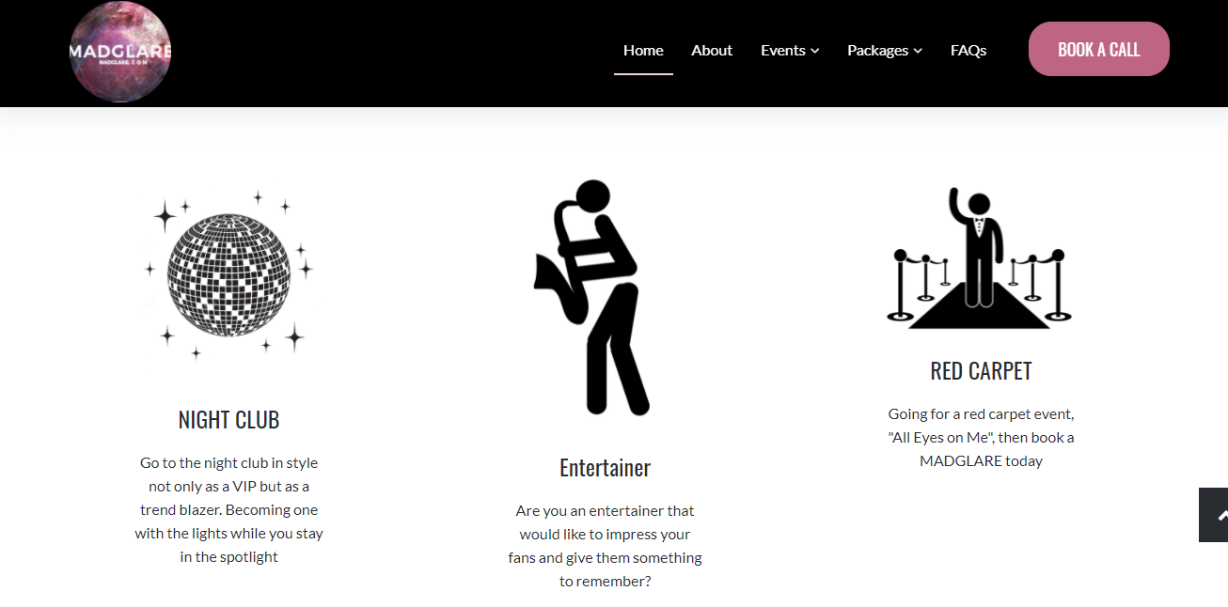
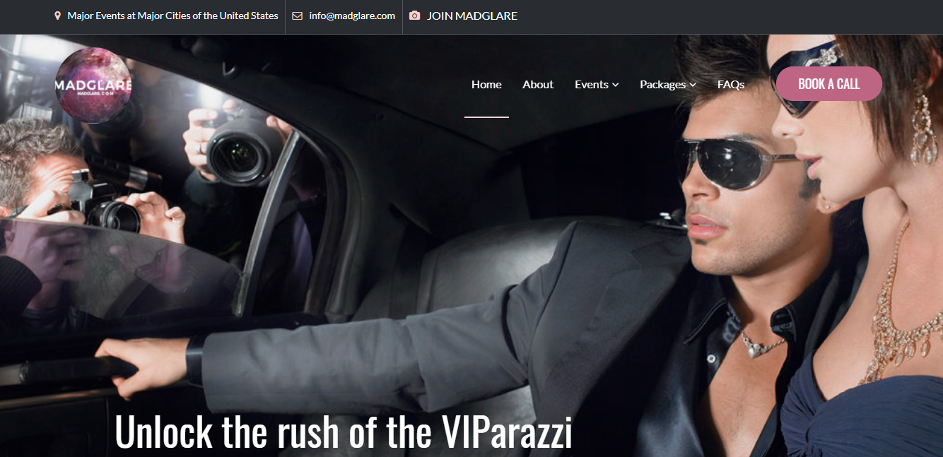
Design
Low Fidelity Mockup
High Fidelity Mock Ups

Slide 20
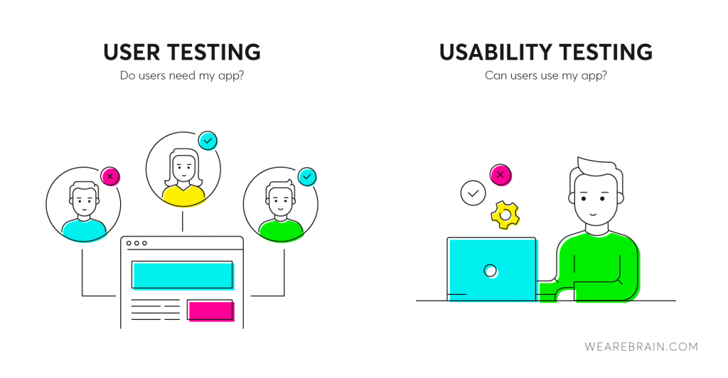
USER TESTING (options)
User-Centered Design with Continuous testing post-deployment so as to offer upgrades. First creating a minimum viable product MVP and then incrementally creating a user-focused design is the best approach. Aligning the user’s mental model with the functionality of the product is crucial. Lean UX designing. Heat map based on pixel targeting Analytic practices to know what users gravitate to the most.
User Testing
User Zoom
Userlytics
Userfeel
UserPeek
uTest

Slide 21

Thank You!
desirel@voltsite.com

